Slide 1
To create a chatbot to support students selecting subjects for Keonics
Assignment
Made by:- YUSUF J
Ktc Hubli

Slide 2
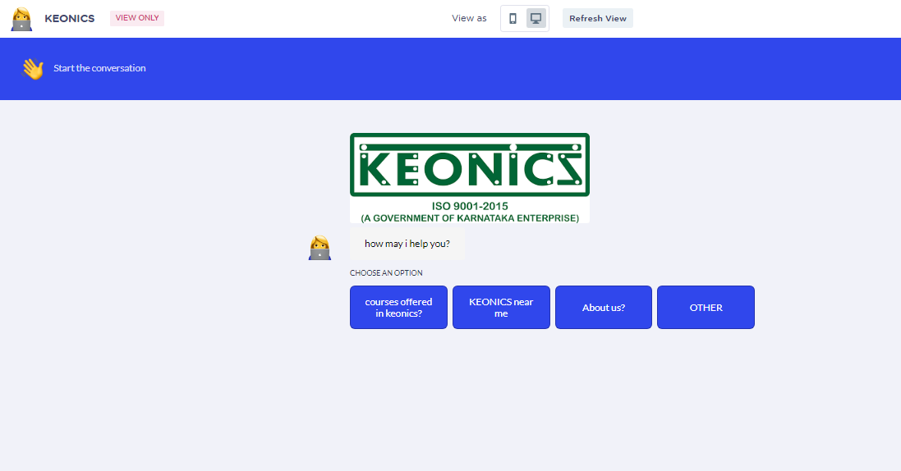
Here, I have created a chatbot named KEONICS in a website called landbot.io

Slide 3
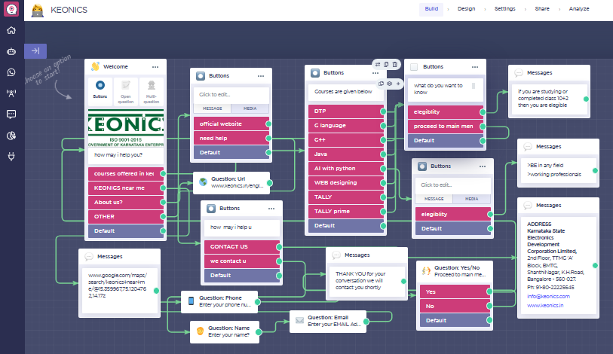
In this website we need to add buttons,url,question box,message box,location,connections as shown below

Slide 4
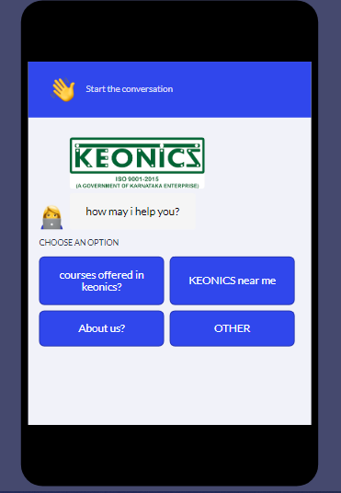
This chatbot supports mobile and as well as in pc

Slide 5
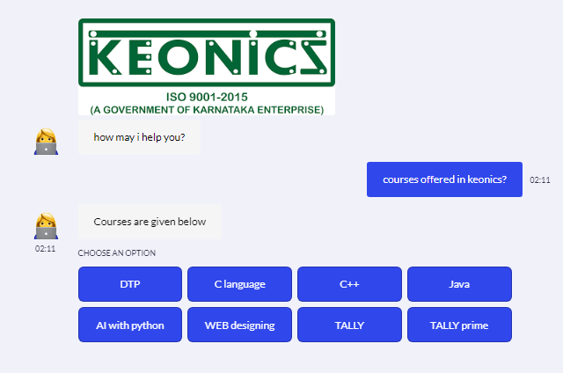
Here we can see that it shows options for courses when clicked on courses offered tab we can select which ever courses we want

Slide 6
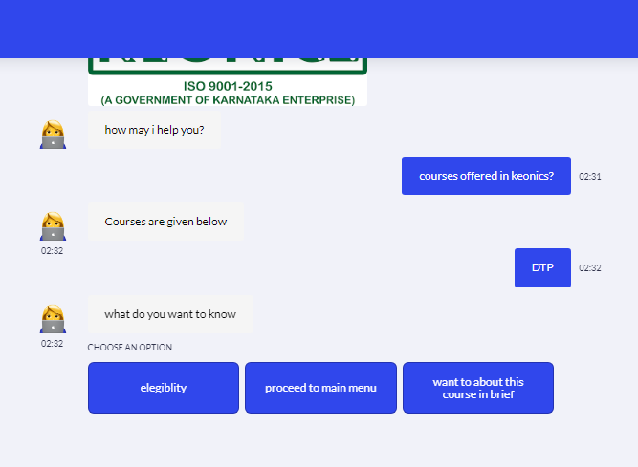
Once we click on any one of the offered courses like DTP we get three options as elegiblity,main menu,know brief

Slide 7
If the student has no idea where exactly is KEONICS near him then he can click on KEONICS near me option it takes you to the nearest KEONICS center located near him in google maps
>If the student want to know about KEONICS then he can click on About us option
>If the student clicks on official website option he can visit on official website
>If the student clicks on help option then he can contcct it asky you will call or we will call you option

Slide 8
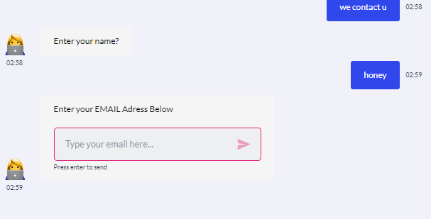
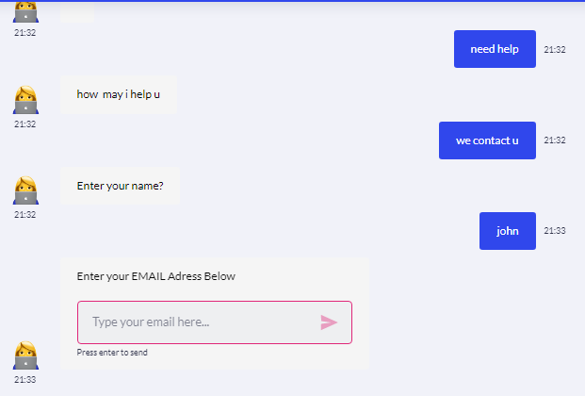
Here student can type their name, email,phone number so that we can contact them later

Slide 9
Benefits:- >can be used for students to detect the location of keonics >know how many courses does keonics offer >know the elegiblity and admission procedure >keonics and students can contact each other

Slide 10
<html> <head> <meta charset="UTF-8"> <meta name="viewport" content="width=device-width, height=device-height, initial-scale=1.0, maximum-scale=1.0, user-scalable=no"> <title>Landbot | Convert a Landing Page into a Chatbot</title> </head> <body> <script SameSite="None; Secure" src="https://cdn.landbot.io/landbot-3/landbot-3.0.0.js"></script> <script> var myLandbot = new Landbot.Fullpage({ configUrl: 'https://landbot.site/v3/H-1319252-KVYQJSLU70RGEQWJ/index.json', }); </script> </body> </html>
Code for chatbot

Slide 11
THANKYOU

